Slide 1

Clustering: Hierarchical and Partitional
Presented By:
Amit Verma 100329477
Sparsh Sharma 100329093
Simardeep Kaur 100329207
Charanjeet Singh 100329356

Slide 2

Hierarchical Clustering
This dataset refers to clients of a wholesale distributor. It includes the annual spending in monetary units (m.u) on diverse product categories.
Our aim is to make clusters from this data that can segment similar clients together.
This data was extracted from UCI machine learning repository: https://archive.ics.uci.edu/ml/datasets/Wholesale+customers
Number of observations: 440
Number of variables: 8

Slide 3
Data Preparation
Data Scaling is preformed in order to make the variables comparable.
Fresh Milk Grocery Frozen Detergents Paper Delicassen
[1,] 0.052873004 0.522972471 -0.041068145 -0.588697039 -0.043519194 -0.066263629
[2,] -0.390857056 0.543838614 0.170124700 -0.269829035 0.086308595 0.089049685
[3,] -0.446520984 0.408073195 -0.028125086 -0.137379340 0.133080157 2.240741903
[4,] 0.099997579 -0.623310408 -0.392530081 0.686363006 -0.498021323 0.093304844
`

Slide 4
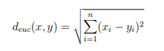
Computing Distance Matrix
Step 1: Data is scaled
Step 2: Distance is calculated using Euclidean method
Step 3: Reformat the result into matrix.
Output:
1 2 3 4 5
1 0.000000 0.620152 2.412450 1.815908 1.851574
2 0.620152 0.000000 2.170333 1.781998 1.920911
3 2.412450 2.170333 0.000000 2.680215 1.728199
4 1.815908 1.781998 2.680215 0.000000 1.659964
5 1.851574 1.920911 1.728199 1.659964 0.000000

Slide 5
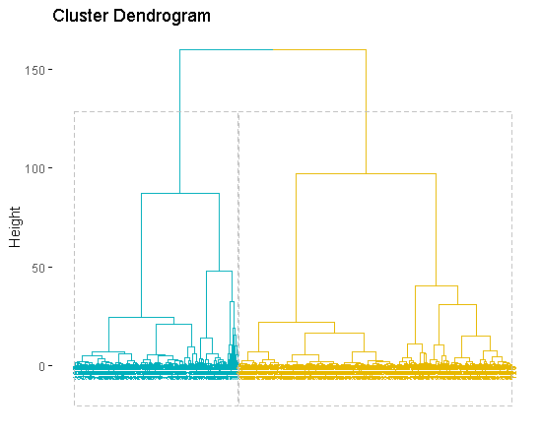
Hierarchical Tree
Step 1: Compute the Euclidean distance matrix.
Step 2 : Compute distance between clusters using
Ward Linkage Method.
Step 3 : Visualize the result in the form
of dendrogram.

Slide 6
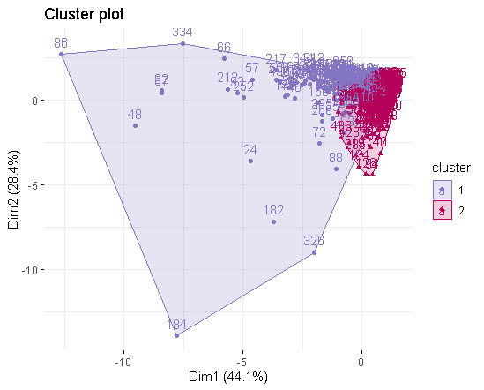
Cluster Plot
Hierarchical methods use a distance matrix as an input for the clustering algorithm.
The choice of an appropriate metric will influence the shape of the clusters.
Interpretation: Cluster Plot is created to visualize the observations in 2 clusters.

Slide 7
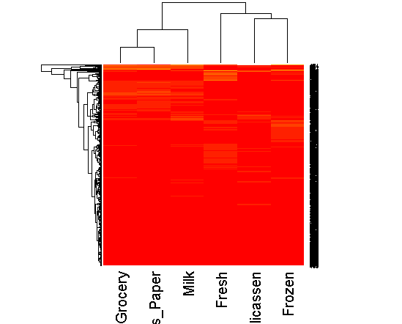
Heat Map
From the heap map it can be observed that there are 2 group of customers.
Group 1
Product Bought: Fresh, Delicassen, Frozen
Group 2
Product Bought: Grocery, Detergent Paper, Milk

Slide 8
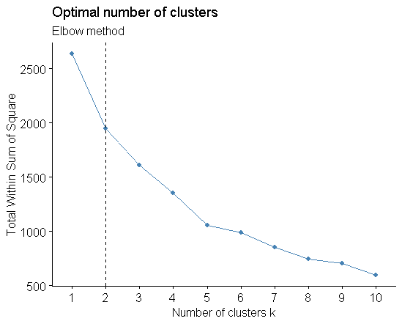
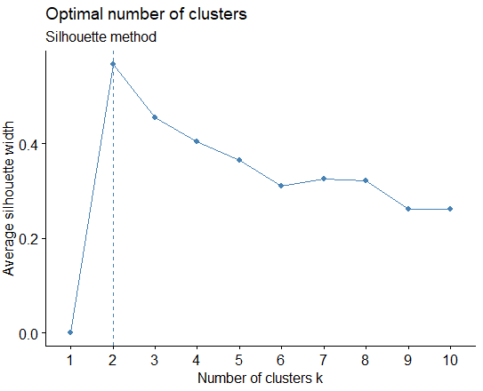
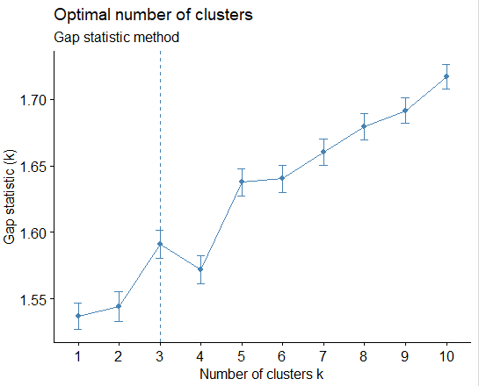
Determining Optimal Number of Clusters
Elbow Method: 2 clusters solution suggested
Gap Statistics: 3 clusters solution suggested
Silhouette Method: 2 clusters solution suggested
So, we will consider 2 clusters for our analysis.

Slide 9
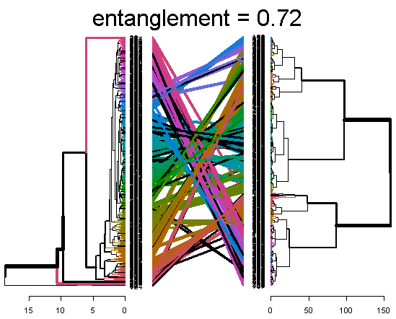
Comparing Dendrograms
In order to check the quality of alignment between the two dendrograms, entanglement is used.
The entanglement is 0.72 which means that the quality of alignment is poor as it should be near to 0.

Slide 10
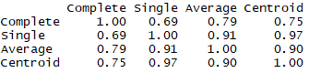
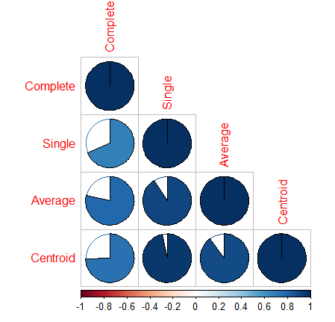
Visualizing Correlation Matrix
Single and Centroid has the maximum correlation coefficient .
Also, the area covered by their pie is the most.
So we should use Single and Centroid for comparison.

Slide 11
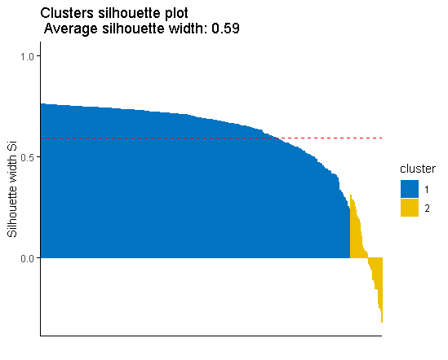
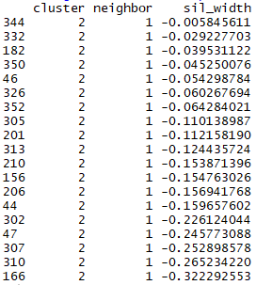
Cluster Validation
Silhouette Measure
Elements with negative silhouette width belong to wrong cluster.
They should belong to its neighbouring cluster i.e. cluster 1.
Continued..

Slide 12
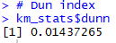
Cluster Validation
Dunn Index
The Dunn’s index is 0.014 which is very small value which depicts that the clusters are not well separated.
Higher Dunn’s index implies more compact and well separated clusters.
Output

Slide 13
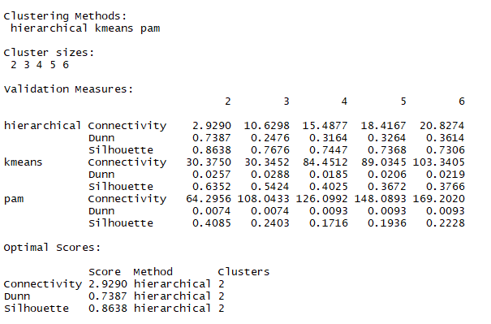
Best Clustering Method
Hierarchical clustering has the lowest connectivity value.
Also, it has highest Dunn’s and Silhouette value
So, we will choose “Hierarchical” clustering for our analysis.

Slide 14
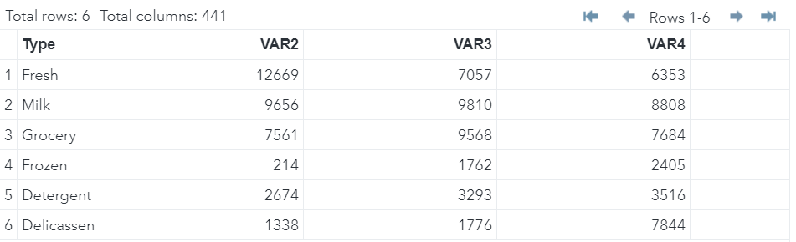
SAS Analysis
Data Preparation
Output

Slide 15
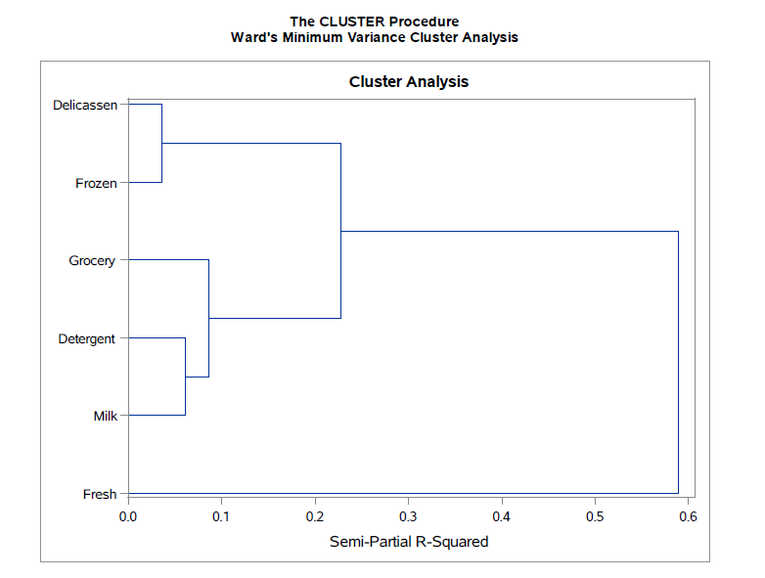
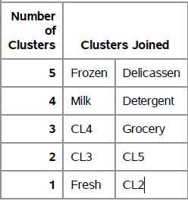
Proc Cluster Method

Slide 16
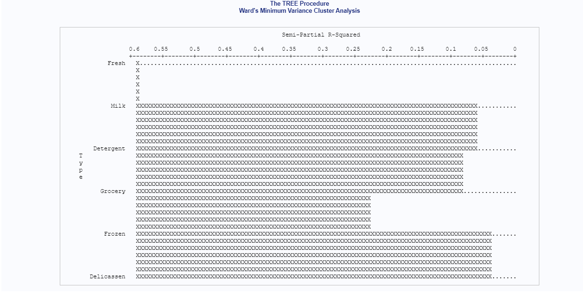
Proc Tree Method
Output
Fresh has the highest R-squared value (i.e. 0.6) while Frozen and Delicassen have the lowest R-squared value (i.e. 0.05).

Slide 17
Partitional Clustering
This dataset consists measurement of geometrical properties of kernels belonging to three different varieties of wheat.
Our aim is to make clusters based on the physical attributes of wheat seeds and the type of wheat.
This data was extracted from UCI machine learning repository: https://archive.ics.uci.edu/ml/machine-learning-databases/00236/
Number of observations: 210
Number of variables : 9

Slide 18
Data Preparation
Data Scaling is preformed in order to make variables comparable.
Output
V1 V2 V3 V4 V5 V6 V7 V8
1 15.26 14.84 0.8710 5.763 3.312 2.221 5.220 1
2 14.88 14.57 0.8811 5.554 3.333 1.018 4.956 1
3 14.29 14.09 0.9050 5.291 3.337 2.699 4.825 1
4 13.84 13.94 0.8955 5.324 3.379 2.259 4.805 1
5 16.14 14.99 0.9034 5.658 3.562 1.355 5.175 1
6 14.38 14.21 0.8951 5.386 3.312 2.462 4.956 1

Slide 19
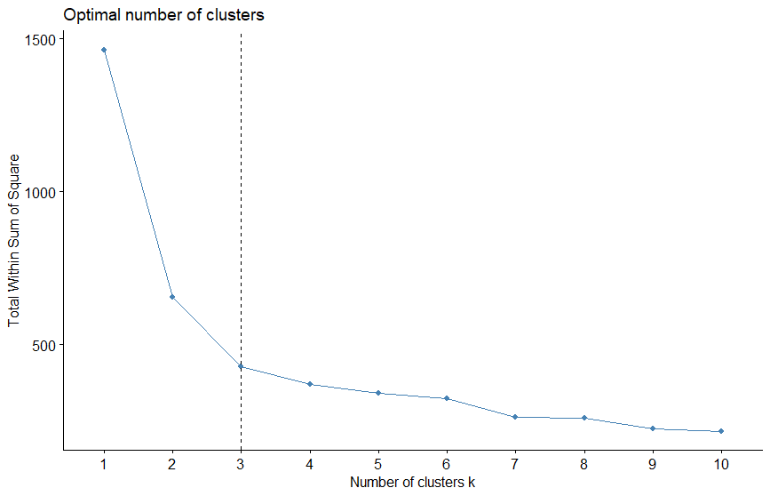
Determining optimal number of clusters: Elbow Method
The plot represents the variance within the clusters.
The bend at k=3 indicates that additional clusters beyond the third have small variance.
So, we'll classify the observations into 3 clusters.

Slide 20
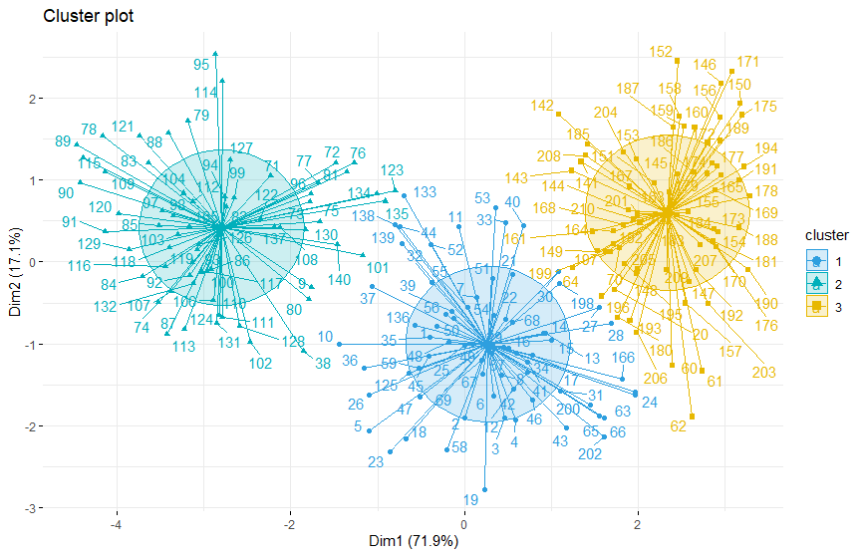
Visualize k-means clusters
3 clusters are formed.
The data points are placed in the three clusters w.r.t the first two principal components coordinates.
These two principal components explains the most variance.

Slide 21
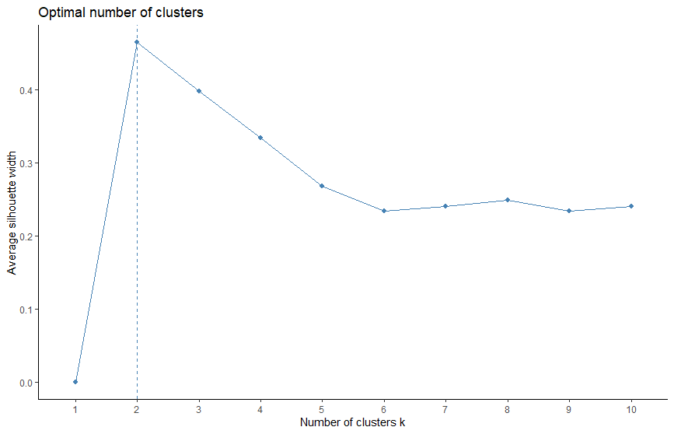
Determining Optimal Number of Clusters: Silhouette Method
PAM stands for Partitioning Around Medoids.
Less sensitive to outliers.
Uses Silhouette method to determine the optimal number of clusters.
The suggested optimal number of clusters are 2.

Slide 22
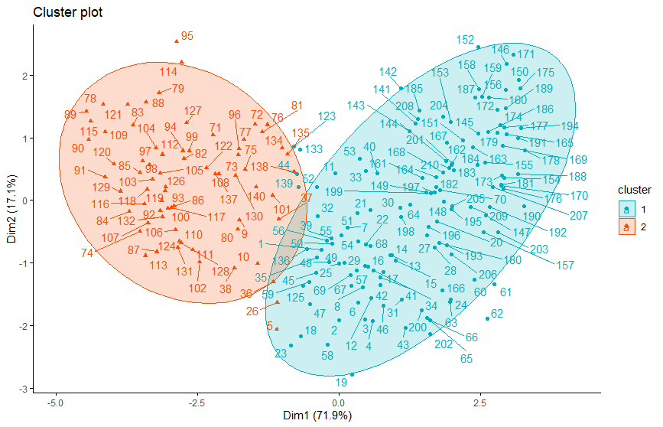
Performing PCA
Two clusters are formed.
The data points are clustered w.r.t the first two principal components
These two principal components explains the most variance.

Slide 23
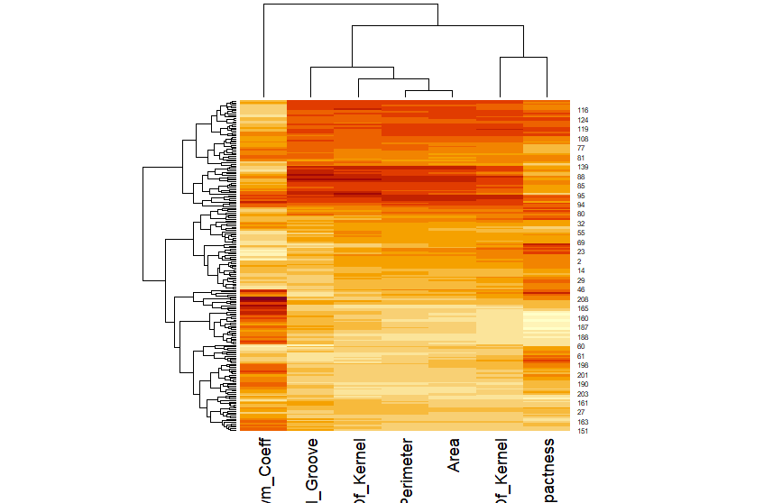
Heatmap
A heatmap (or heat map) is another way to visualize clustering. It's also called a false colored image, where data values are transformed to color scale. Heat maps allow us to simultaneously visualize clusters of samples and features.
According to the output there are 3 clusters formed along the y-axis which represent 3 different types of kernels

Slide 24
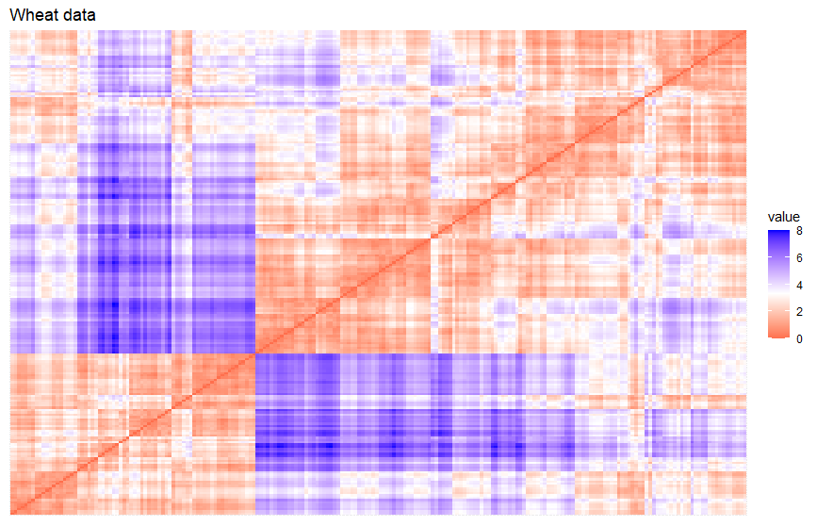
Evaluating Clustering Tendency
Dissimilarity Matrix
Hopkins Test Result:
The Hopkins values lies between 0 to 1.
Since the output is .8 which is nearer to 1, so the dataset is not clusterable.
Dissimilarity Matrix (VAT)
Determine number of cluster based on blocks on diagonal.
3 blocks are formed on diagonal.
Hopkins Test
Output:
[1] 0.8027413

Slide 25
Hubert Index
*******************************************************************
* Among all indices:
* 10 proposed 2 as the best number of clusters
* 11 proposed 3 as the best number of clusters
* 1 proposed 6 as the best number of clusters
* 1 proposed 10 as the best number of clusters
***** Conclusion *****
* According to the majority rule, the best number of clusters is 3
*******************************************************************
Hubert index is a graphical method of determining the number of clusters.

Slide 26
Best Clustering Method
Connectivity:
Corresponds to what extent items are placed in same clusters their nearest neighbours in the data space.
Value ranges from 0 to 1.
Dunn Index:
Inter cluster distance is the minimum distance from any member of one cluster to any member of another cluster.
Silhouette:

Slide 27
Stability Measures
For the APN and ADM measures, kmeans clustering with two clusters gives the best score. For the AD measure, PAM with six clusters has the best score while for FOM measure, PAM with 5 clusters has the best score.

Slide 28
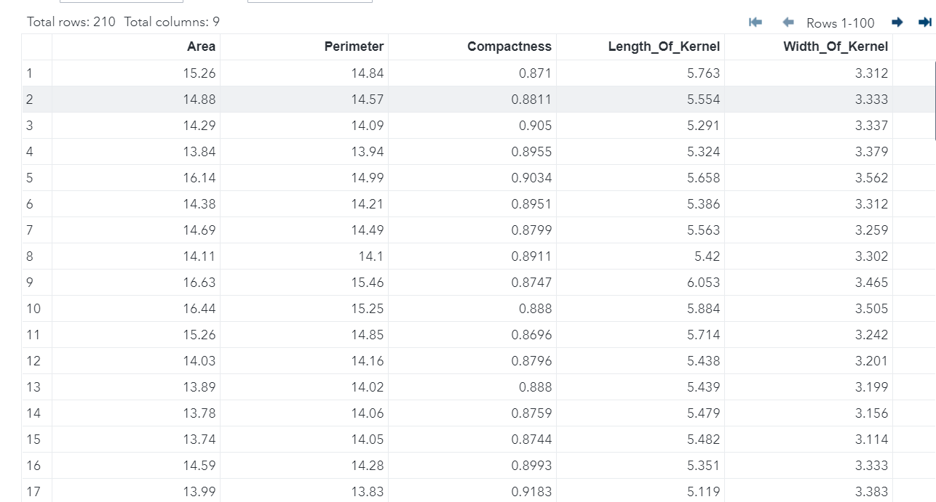
SAS Analysis
Data Preparation
Output
Read the data into SAS environment using import command.

Slide 29
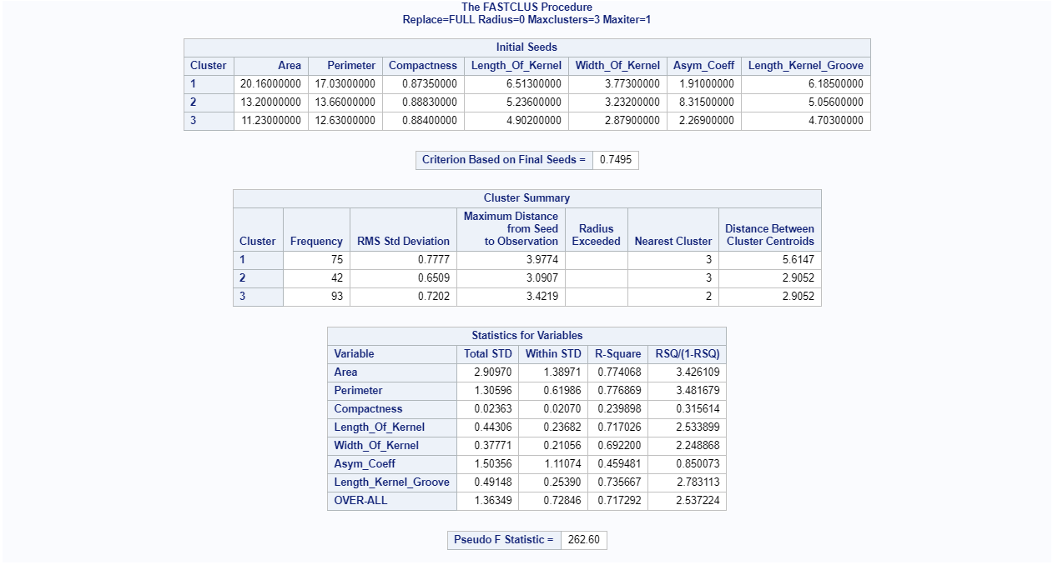
K-Means Clustering
Continued..

Slide 30
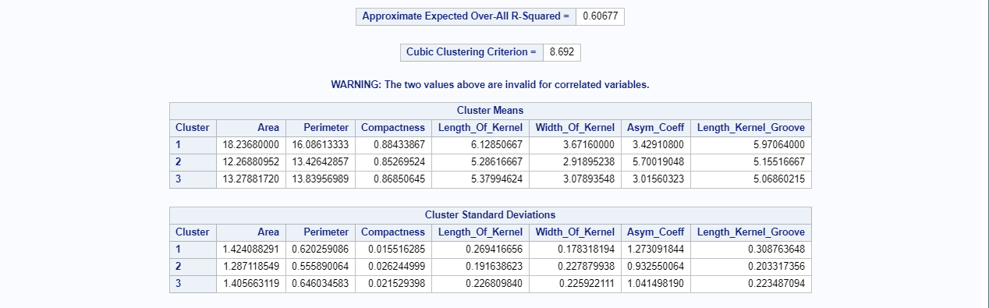
K-Means
Output

Slide 31
THANKS!

